Slide 1
Software Architecture Context

Slide 2
Contexts of Software Architecture
Technical - technical role in the system or systems of which it’s a part
  e.g. need to build a bank mobile app / new microservice for an existing system
    What are the integrations? How are they designed to fit in?
    How to maintain the context’s qualities? (availability, accessibility, scalability, etc)
Project life cycle - relationship to the other phases of a software development life cycle
  Requirements affect architecture, architecture affects every step
  Different processes in different organizations
Business - affects (& affected by) an organization’s business environment
  e.g. legacy system can prevent offering new services quickly
Professional - role of a software architect in an organization or development project
  Not just diagrams
    Business / developers translator
    Trade-offs & negotiations

Slide 3
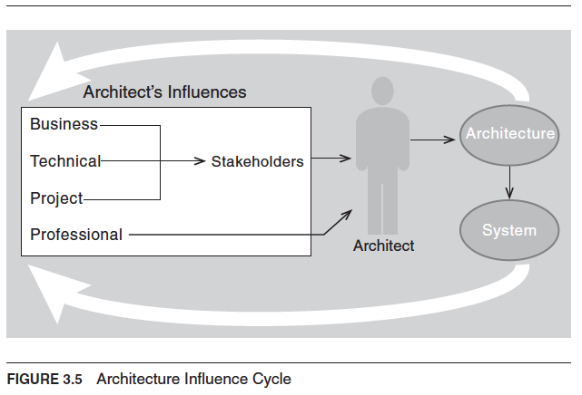
Architecture Influence Cycle
Business
Loudest voice – mission, funding
Revenue, time-to-market (T2M), regulations, quality attributes, etc
Tech
Available technologies, existing systems, integration constraints
Project
Project triangle – Scope, cost, schedule
Process details
Professional
Experience, training, and prior decisions influence choices
© Len Bass, Paul Clements, Rick Kazman, distributed under Creative Commons Attribution License
Notes:
Scope, cost, time

Slide 4
Intricate Interactive Waltz of
Influence and Counterinfluence
Architecture is a sociotechnical activity — architects must actively engage stakeholders and bring both technical and interpersonal skills
Architects must identify and actively engage the stakeholders
  To solicit their needs and expectations
  A lost stakeholder → project at risk
  Unsatisfied stakeholder → project at risk
Software architects must have
  Communication skills – communicate solutions, both written and verbally
  Collaboration skills – co-create solutions, not dictate them
  Negotiating skills – find compromises without losing architectural integrity
  Comprehensive technical and domain knowledge
  Technical correctness AND politically savvy
“90% social sciences and diplomacy, 10% technology!”

Slide 5
The Architecture Milieu of Influences
Project
Business Context
Mission and funding
Functional requirements
ASRs
Business goals and constraints
Project Context
Schedule and budget
ASRs
SDLC model
e.g. waterfall, iterative or agile
Stakeholders
Software Architecture
Technology
Professional Context
ASRs
Experience
Knowledge
Bias
Training
Technology Context
ASRs
Constraints
Legacy systems
External systems
Platforms
Standards
Emerging technologies
Architects
Notes:
Business – represented by stakeholders
Professional – represented by architects (& devs)

Slide 6
The Architecture Milieu of Influences
Project
Business Context
New business opportunities
Requirements for next systems
Economies for support and development
Project Context
Prescribe development structure
Change engineering culture
Technical development environment
Stakeholders
Software Architecture
Technology
Professional Context
Architect’s experience and knowledge – what works, what doesn’t
Architect's reputation and portfolio
Technology Context
Requirements for future systems
Technology standards for the organization
Architects

Slide 7
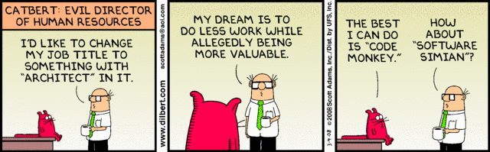
What is the Role of a Software Architect?

Slide 8
Architecture in the Product Life-Cycle
Inception
Elaboration
Construction
Transition
Upgrade
Envision
Create
and
Analyze
Architecture
System
Reuse
Other Products
Inception
ASRs Elicited & Prioritized
Architectural Baseline
Inception
Architect’s Involvement
Highest
Lowest

Slide 9
Architecture in Agile Projects
Sprint 0
Sprint 1
Sprint 2
Sprint 3
Sprint N
Architectural runway – enough to start
Key technology and pattern decisions
Set up CI/CD pipeline
ASRs emerge and are refined
Build thin vertical slice
Architect’s Involvement
Highest
Lowest

Slide 10
Architect’s Responsibilities
Contribute to the business case for the system
  Understand technical feasibility and cost trade-offs
Understand the architecturally significant requirements
Design or select the architecture
  e.g. IoT devices → event-driven
Document, communicate, and advocate for the architecture
Analyze or evaluate the architecture
  Stress-test against scenarios (load testing, security, quality attributes, etc)
Guide and validate implementation for architectural conformance

Slide 11
Architecture Decision Scope and Impact
 | Low Impact | High Impact (high priority, important to business)
Local | Not architectural e.g. functions, classes, local libraries | Not generally architectural (though might set architecture guidelines and policies as needed) e.g. choice of ORM — if mandated, ripple effects across codebase
Systemic (broad scope) | Not architectural ⚠ trap! e.g. standard indentation style — covers whole system but doesn’t matter architecturally | Architecturally Significant → ASR candidates e.g. vendor lock-in vs open source; monolith vs microservices

Slide 12
Software Architect Role Profile
Architecture design but also …
System software and hardware selection
Build vs. buy decisions
Architecturally significant requirements
Development methodology, process, standards
Technical and project leadership
Coaching and mentoring
Hands on construction
Leverage experience, track technology trends

Slide 13
Software Architect Role
(Job Description)
The software architect creates a vision
  Keeps up with innovations and technologies
  Understands global requirements and constraints (business and technical)
  Creates a vision (global view) of the system
  Communicates the vision effectively
  Provides requirements and inputs to the system architect (if separate role)
The software architect is the key technical consultant
  Organizes the development team around the architecture design
  Manages dependencies
  Reviews and negotiates requirements
  Assesses technical capabilities of staff
  Motivates the team
  Recommends technology, training, tools
  Tracks the quality of the design
  Ensures architecture meets its design goals
(from Hofmeister et al., Applied Software Architecture)

Slide 14
Software Architect Role (continued)
The software architect makes decisions
  Leads the design team
  Makes early design decisions (key global ones)
  Knows when to end discussion and make a decision
  Identifies and manages risk
The software architect coaches
  Establishes dialog with each team member
  Teaches the team the architecture design and gets their buy-in
  Listens to feedback
  Knows when to yield to design changes
  Knows when to let others take over detailed design
The software architect coordinates
  Coordinates activities of tasks that influence or are influenced by the architecture
  Maintains integrity of the design
  Ensures that the architecture is followed

Slide 15
Software Architect Role (continued)
The software architect implements
  Considers the design implications of introducing a new technology
  May look at low-level details to validate initial concepts
  May prototype to explore and evaluate design decisions
  May implement a thin vertical slice to minimize implementation risk
  May implement components as an implementation model for developers
The software architect advocates
  Advocates investment in software architecture
  Works to incorporate software architecture into the software process
  Continues to assess and advocate new software architecture technologies
  Advocates architecture reuse

Slide 16
Career Path
Set your sights on becoming an expert in software engineering
  Gather broad experience
  Develop technical, leadership, communication and people skills
  Self-learning
Apprentice (hang out) with an experienced architect, or better get an architect mentor
  You are an average of 5 people with whom you communicate most
  If you are the smartest person in the room, you're in the wrong room
  Don't wait for a promotion to start doing the next job – demonstrate the capability first
Individual
Contributor
Software
Engineer
Senior
Software
Engineer
Lead
Software
Engineer
Architect
Increasing responsibility, scope and challenge
(from Hofmeister et al., Applied Software Architecture)

